Slide 1
Final Project
Garage Door Opener
By: Alexander Reinhardt

Slide 2
Introduction
For my final project, my goal was to design a garage door opener that could be controlled through wifi by my phone.
This was accomplished by setting up a radio transmitter with my raspberry pi and interfacing with it using a web app on my phone.
I had a few pitfalls but found a solution that works.

Slide 3
How it works
I use an app on my phone to send an http request to a putty server running on my pc.
The pc server sends several coap requests to the raspberry pi to gather data or control the garage door.
The raspberry pi controls the radio transmitter, which releases a signal that activates the garage door.

Slide 4
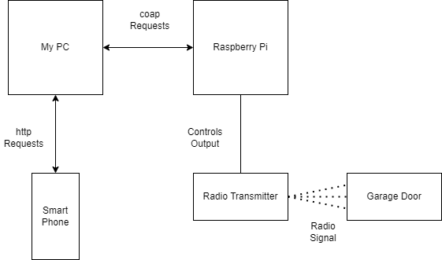
Network diagram

Slide 5
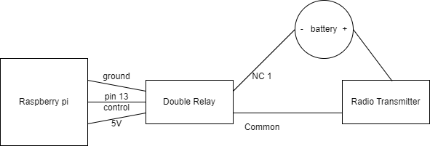
Circuit diagram

Slide 6
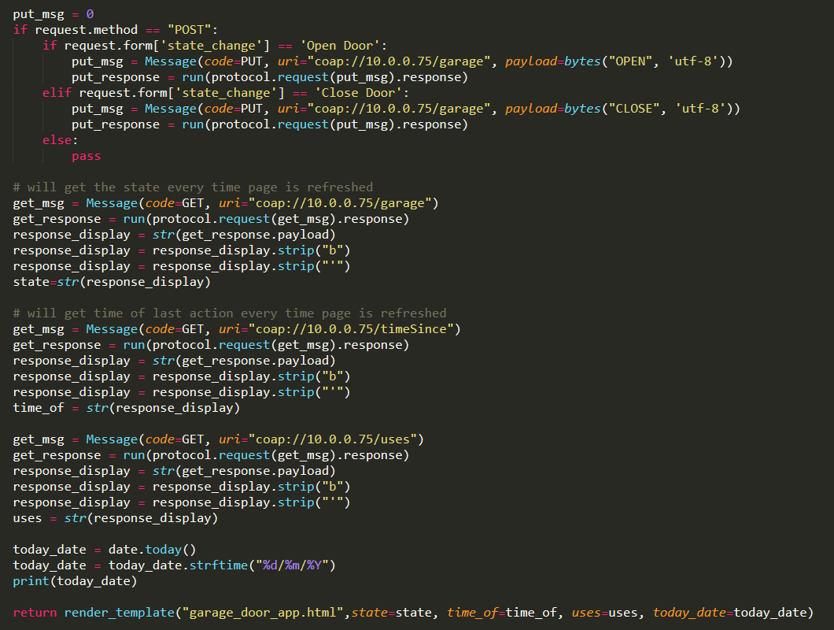
The putty server

Slide 7
The coap server
3 resources on the server
DoorStateRecource keeps track of the state of the garage door and changes it
TimeOfDoorResource keeps track of the last time an action was taken by the server
UsesOfDoorResource keeps track of how many times an action has been performed

Slide 8
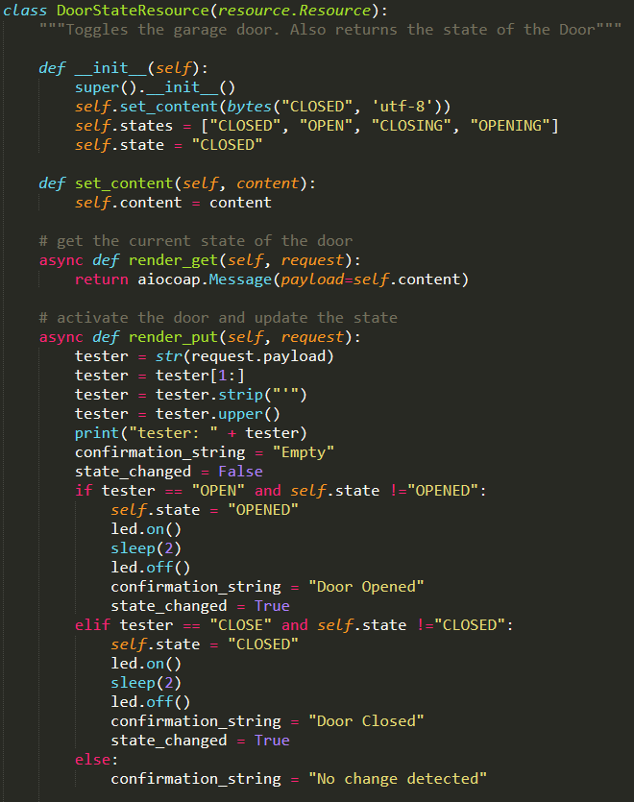
Door State

Slide 9
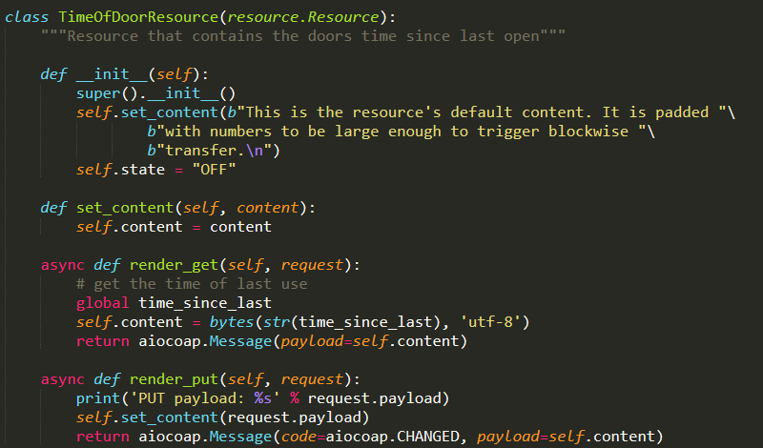
Time of last action

Slide 10
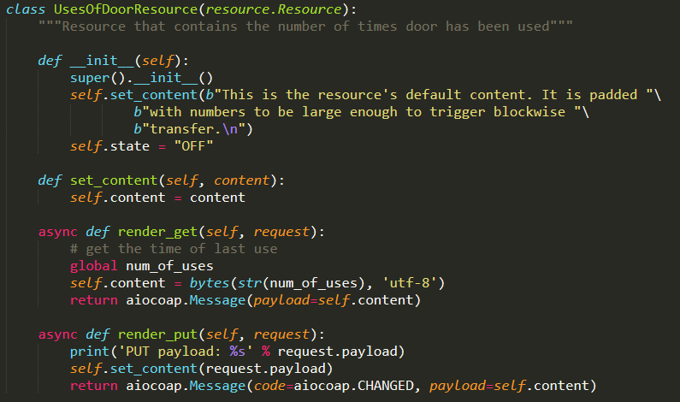
Uses of door

Slide 11
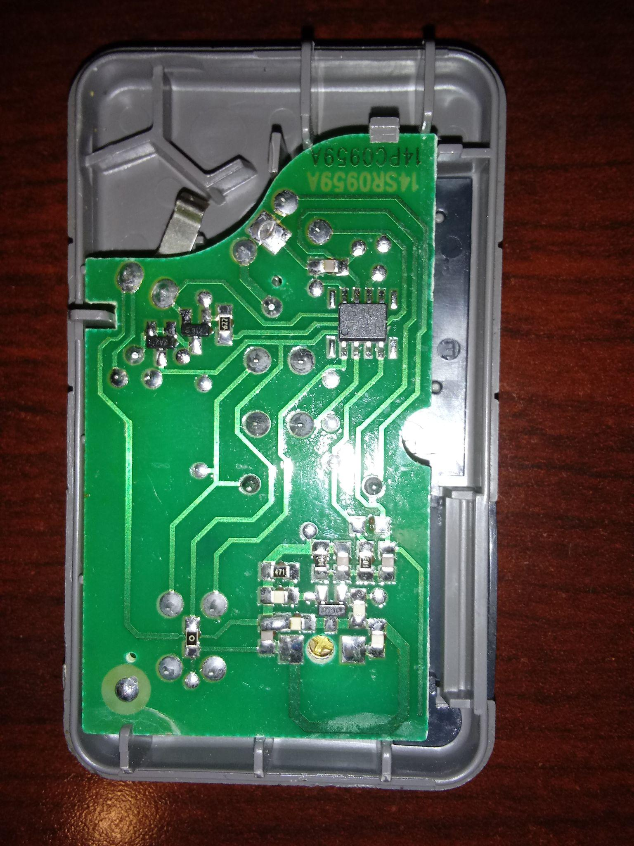
Radio transmitter

Slide 12
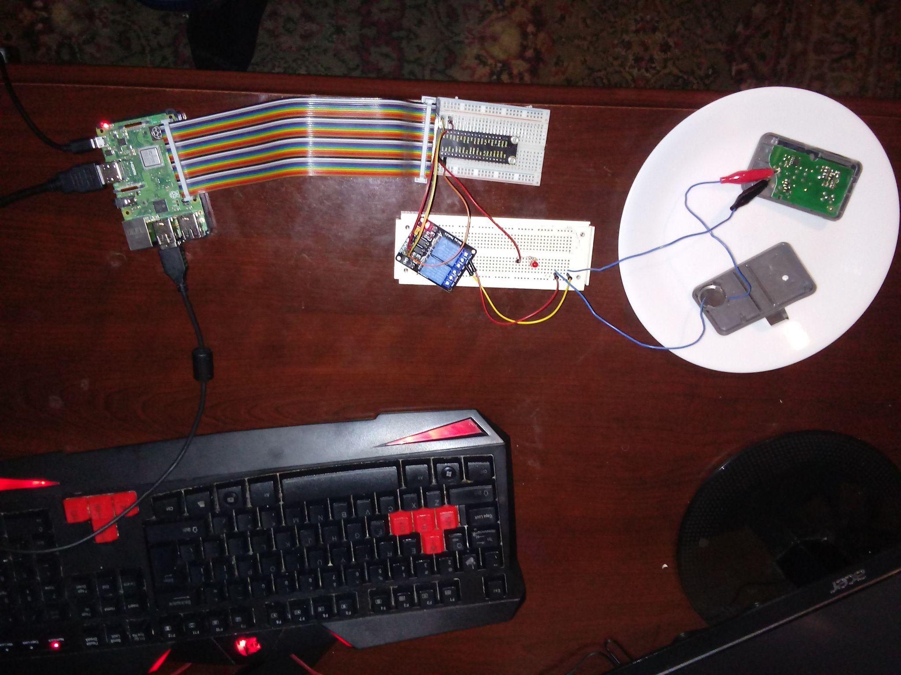
Full circuit

Slide 13
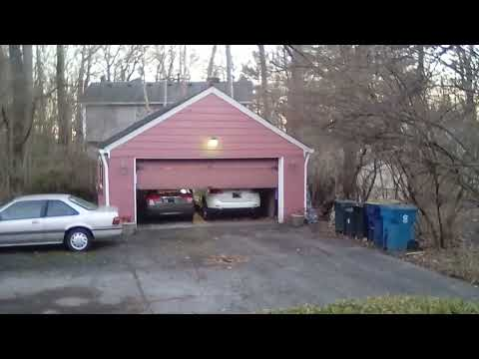
Demo

Slide 14
Wireshark packets

Slide 15
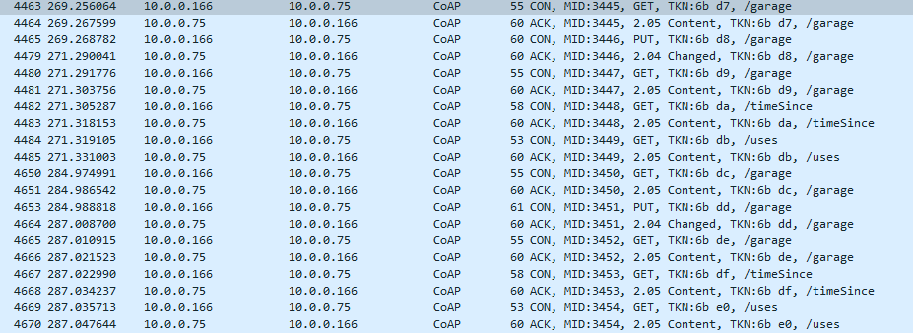
Wire Shark Packets cont

Slide 16
Pitfalls
Sending a radio signal with the pi
Pi can only send op to 250 MGhz radio signal (need 315)
Special code needs to be sent with radio signal
Interfacing with pi using smartphone
Hard to run python code on smartphone, easier to make web app
Pi’s control over the radio transmitter
Needed a relay to control the current through the transmitter suing a 3V battery

